Slide 1
Module -3
BY Dr.Srividya.L
Mobile communication systems: History of mobile communication systems G to 5G. Global System for Mobile Communication (GSM)- features and services, Architectural review, IS-95 and CDMA 2000, Historical Overview, System Overview.

Slide 2
Industrial and technological revolution: from steam engines to the Internet
The massive and wide spread adoption of mobile connected devices is further driving deep societal changes with tremendous economic, cultural and technological impact to a society that is becoming more networked and connected.
Humanity is going through a phase of a technological revolution that originated with the development of semiconductors and the integrated circuit and continued with the maturing of Information Technology (IT) sector and the development of modern electronic communication in the 1970s and 1980s, respectively.

Slide 3
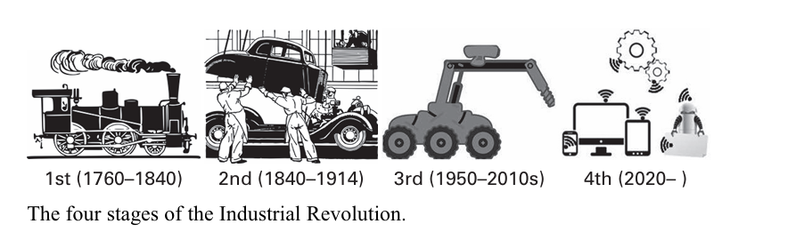

Slide 4
Four stages of industrial evolution
First 1760–1840- introduction of the power loom and the steam engine.
Second-1840–1914-introduction of the Bessemer steel process and culminated in early factory electrification, mass production and the production line.
Third-1950–2010s-introduction of Programmable Logic Controllers (PLCs). This allowed further automation of the production process and an increase in productivity.
Fourth-current-a new generation of wireless communications enables pervasive connectivity between machines and objects, which itself enables another leap in industrial automation.

Slide 5
5G will enable the fourth stage of the Industrial Revolution by extending wireless communications from humans to a fully connected world of humans and objects. It will have:
• connectivity as a standard for people and things,
• critical and massive machine connectivity,
• new spectrum bands and regulatory regimes,
• mobility and security as network functions,
• integration of content distribution via the Internet,
• processing and storage at the network edge and
• software defined networking and network function virtualization.

Slide 6
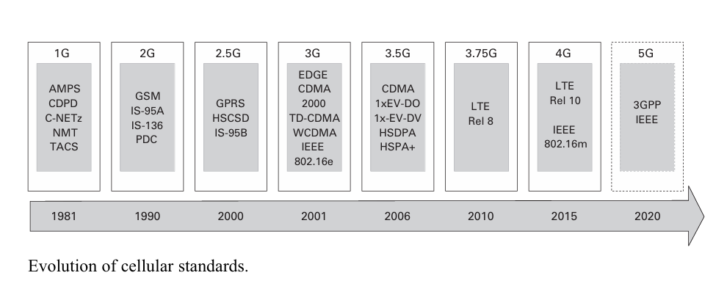
Mobile communications generations: from 1G to 4G

Slide 7
1G - First Generation (Analog)
Title: 1G - The First Generation Mobile Communication
Content:
Deployment: 1950s-1960s (early commercial use).
Key 1G Standards:
NMT (Nordic countries)
C-Netz (Germany, Portugal, South Africa)
TACS (UK)
AMPS (Americas)
Technology: Analog, frequency-modulated radio signals, digital signaling channel.

Slide 8
Characteristics of 1G (Analog) Technology
Analog technology for voice communication.
Limited coverage and low penetration.
Focus on voice services with no data capabilities.

Slide 9
The Birth of 2G – The Move to Digital

Slide 10
2G: The Shift to Digital Communication
1982: CEPT decided to develop a pan-European 2G system.
GSM became the dominant 2G standard.
Deployment: 1991 onwards.
Introduction of digital transmission and switching technology.
Key Features of GSM:
Digital transmission and switching.
Improved voice quality and network capacity.
International roaming across Europe.
Introduction of supplementary services like SMS (Short Message Service).
Technology: Hybrid TDMA/FDMA (in contrast to 1G’s FDMA).

Slide 11
Other 2G Digital Systems Worldwide
TIA/EIA-136 (NA-TDMA) - North American TDMA standard.
TIA/EIA IS-95A (CDMA One) - CDMA-based standard.
PDC (Personal Digital Cellular) - Exclusively in Japan.

Slide 12
2.5G - The Evolution of 2G
2.5G - General Packet Radio Service (GPRS)
Introduction of packet-switched data services alongside voice and circuit-switched data.
Key Feature: Enabled basic mobile internet services.
2.5G - GPRS and EDGE Evolution
Key Standards: GPRS (extension of GSM) and TIA/EIA-951 (extension of IS-95A).
Technology: Introduction of packet data services, GPRS as a stepping stone for EDGE.
EDGE: Enhanced data rates using higher order modulation and coding schemes.

Slide 13
Evolution of GSM/EDGE to Enhanced Data Rates
GSM/EDGE evolves with enhancements in data rates and carrier aggregation.
EDGE: Further developed into Enhanced General Packet Radio Service (EGPRS).
Key Feature: Support for higher bandwidths and carrier aggregation for the air interface.

Slide 14
Transition to 3G

Slide 15
The Path to 3G - Development of UMTS
1998: CDMA adopted as UMTS (Universal Mobile Telecommunications System).
Technologies: WCDMA and TD-CDMA.
IMT-2000: International Mobile Telecommunications 2000 classification.

Slide 16
3G Evolution: 3.5G (HSPA)
3.5G - High-Speed Packet Access (HSPA)
HSPA combines HSDPA (High-Speed Downlink Packet Access) and HSUPA (High-Speed Uplink Packet Access).
Key Feature: Enhanced packet data rates, up to 14.6 Mbps downlink and 5.76 Mbps uplink.
MIMO: Introduction of Multiple Input, Multiple Output technology for higher data rates.

Slide 17
4G - Long Term Evolution (LTE)

Slide 18
4G - LTE and the Shift to OFDMA
LTE: New air interface based on Orthogonal Frequency Division Multiple Access (OFDMA).
Architecture: System Architecture Evolution/Evolved Packet Core (SAE/EPC).
Key Feature: Higher spectrum blocks and flexible component frequency carriers.

Slide 19
LTE Release 8 and IMT-Advanced
Release 8: Peak data rates up to 326 Mbps, lower latency (20 ms), and increased spectral efficiency.
Transition to 4G: LTE initially considered a precursor to 4G, later accepted as 4G.
IMT-Advanced: Specifications for future 4G, supporting carrier aggregation and higher order MIMO.
LTE Evolution: Release 10 and Release 11
Release 10: Improved capacity through higher order MIMO and carrier aggregation up to 100 MHz bandwidth.
Release 11: Further improvements with advanced features like interference cancellation and coordinated multipoint (CoMP).

Slide 20
LTE Release 12 & 13: Supporting MTC and IoT
LTE-M and NB-IoT: Designed for Machine Type Communication (MTC) devices, offering extended coverage and low power consumption.
Release 13: Carrier aggregation up to 32 carriers, targeting extreme broadband data rates.
Global Mobile Market Growth and Trends :
GSM/EDGE: Dominates with 57% market share (4.26 billion subscribers).
3G (HSPA): 26% market share (1.94 billion subscribers) since 2010.
Global Subscribers: 7.49 billion subscribers worldwide by 2015.
HSPA Subscription Peak: Expected to peak by 2020 and decline afterward.
LTE Growth: LTE reached 910 million subscribers by the end of 2015 and is expected to hit 4.1 billion by 2021, becoming the largest mobile technology.

Slide 21
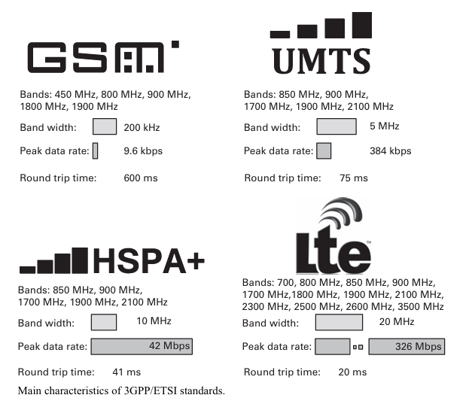

Slide 22
The Trend of 3GPP Standards
3GPP Standards: Spectrum, Bandwidth, and Efficiency
Trend: Widespread use of spectrum, higher bandwidths, higher spectral efficiency, and lower latency.
Figure 1.3 (illustrate the trend in the graph showing 3GPP standard features).

Slide 23
GSM–GlobalSystemforMobileCommunications
1 HistoricalOverview 2 SystemOverview
BaseStationSubsystem NetworkandSwitchingSubsystem OperatingSupportSystem 3 TheAirInterface 4 LogicalandPhysicalChannels LogicalChannels MappingBetweenLogicalandPhysicalChannels 5 Synchronization FrequencySynchronization TimeSynchronization TimingAdvance SummaryofBurstStructures 6 Coding VoiceEncoding ChannelEncoding Cryptography FrequencyHopping
7 Equalizer
8.Circuit-SwitchedDataTransmission
9 EstablishingaConnectionandHandover
IdentityNumbers IdentificationofaMobileSubscriber ExamplesforEstablishmentofaConnection ExamplesofDifferentKindsofHandovers
10 ServicesandBilling AvailableServices Billing

Slide 24
GSM– Global System for Mobile Communications

Slide 25
1. Historical Overview of GSM

Slide 26
1. Historical Overview of GSM
Introduction:
GSM (Global System for Mobile Communications) is the most successful mobile communication system worldwide.
Developed in 1982 by CEPT (later ETSI), the aim was to create a pan-European digital mobile communication system.
Objectives:
Technical Goal: A better and more efficient wireless communication system, superior to analog systems.
Political Goal: A single standard for all of Europe, enabling cross-border roaming.

Slide 27
GSM Development and Evolution
Early Development:
Proposals included multiple access methods: TDMA, FDMA, CDMA.
After testing and political decisions, TDMA was selected as the basis.
The final system was a compromise between multiple companies to avoid competitive advantage.
Evolution of GSM:
Phase-2 Specifications (1995): Added functionalities to GSM.
GPRS and EDGE: Introduced as enhancements, leading to GSM 2.5th Generation.

Slide 28
Global Expansion and Technical Details
Global Success:
Originally designed for Europe, GSM expanded worldwide.
Australia was the first non-European country to adopt GSM.
By 2009, GSM had almost 3.5 billion subscribers.
Frequency Bands(versions)
GSM900 (original), GSM1800 (DCS1800), GSM1900 (PCS1900 in the USA).
Open Standard:
GSM is an open standard, ensuring compatibility across different manufacturers.
Providers can choose equipment from different suppliers for network expansion.

Slide 29
2.GSM System Overview

Slide 30
2.GSM System Overview
Key Components of GSM:
Base Station Subsystem (BSS)
Network and Switching Subsystem (NSS)
Operation Support System (OSS)

Slide 31
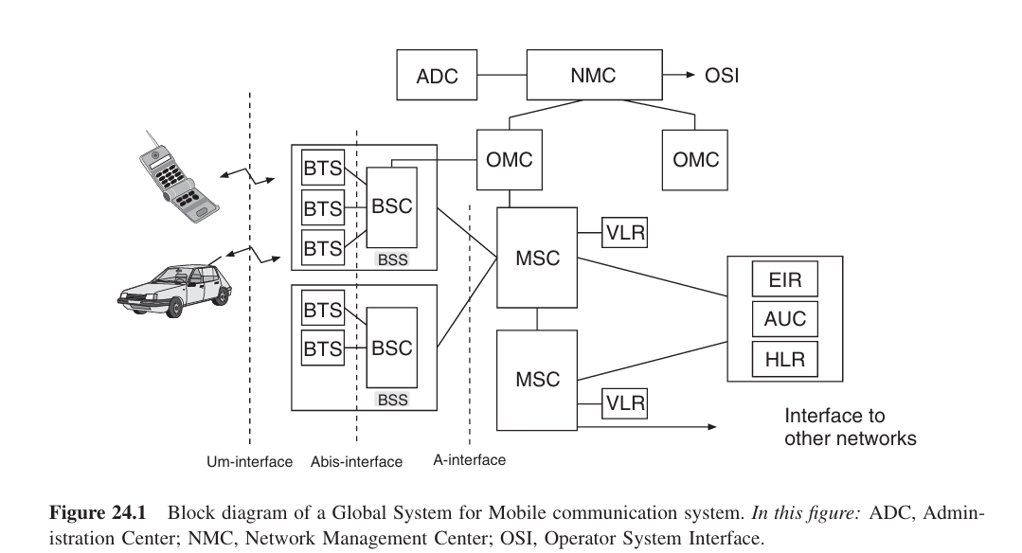
Block diagram

Slide 32
Base Station Subsystem (BSS) Overview
Components of BSS:
Base Transceiver Stations (BTS): Establish and maintain connections with Mobile Stations (MSs).
Base Station Controllers (BSC): Control and manage multiple BTSs.
Interfaces:
Um Interface: Between MS and BTS (air interface).
Abis Interface: Between BTS and BSC (not fully standardized).

Slide 33
BSS Functionality and Operations
Functions of BSS:
Channel Assignment: Allocating communication channels to MSs.
Link Quality Maintenance: Ensuring consistent communication quality.
Handover (HO): Switching between BTSs within the same BSC.
Power Control, Coding, and Encryption: Ensuring signal strength, secure communication, and error management.
Efficiency Considerations:
BSC may control several BTSs, shifting functionality to improve efficiency but increasing signaling traffic on the BTS-BSC link.

Slide 34
Network and Switching Subsystem (NSS)
The NSS is a key component of the GSM network.
Main function: Controls traffic between different BSCs.
Key element: Mobile-services Switching Center (MSC).
Functions of the MSC
Mobility Management: Ensures seamless movement of subscribers.
Handover Management: Transfers MS between BSCs.
Paging & Location Update: Keeps track of subscriber locations.
Network Interaction: Connects to PSTN and other networks.

Slide 35
Databases in NSS
Home Location Register (HLR): Stores subscriber details and location.
Visitor Location Register (VLR): Tracks roaming subscribers.
Authentication Center (AUC): Verifies user identity.
Equipment Identity Register (EIR): Stores info on stolen/misused devices.

Slide 36
Operating Support System (OSS)
OSS manages network operations and maintenance.
Supports administrative and technical tasks.
Key Functions of OSS
Accounting: Tracks call costs and subscriber plans.
Maintenance: Ensures hardware & software reliability.
MS Management: Detects and blocks faulty devices.
Data Collection: Monitors traffic and link quality.

Slide 37
Accounting in OSS
Determines call costs for subscribers.
Manages different service plans.
Handles administrative complexity.
Maintenance in OSS
Hardware failures require technician visits.
Software issues can be managed remotely.
Centralized updates for switching software.
MS Management & Data Collection
Identifies devices causing interference.
Blocks unauthorized MS activities.
Monitors network performance and traffic.

Slide 38
3.The Air Interface

Slide 39
3.The Air Interface
GSM employs a combined FDMA/TDMA approach which further combines with Frequency Domain Duplexing (FDD)
FDD
First GSM version used:
890–915MHz (Uplink)
935–960MHz (Downlink)
GSM1800:
1,710–1,785MHz (Uplink)
1,805–1,880MHz (Downlink)
North America:
1,850–1,910MHz (Uplink)
1,930–1,990MHz (Downlink)
45MHz spacing ensures separation between uplink and downlink.

Slide 40
Frequency Division Multiple Access (FDMA)
Uplink and downlink bands are divided into a 200-kHz grid.
Outer 100 kHz of each 25 MHz band is reserved as a guard band.
124 subbands available, identified by Absolute Radio Frequency Channel Numbers (ARFCNs).

Slide 41
Time Division Multiple Access (TDMA)
Uses Gaussian Minimum Shift Keying (GMSK) modulation.
Each 200-kHz subband supports 271 kbit/s.
Each subband is shared by eight users.
TDMA Frame Structure
Each timeslot: 576.92μs long, carrying 156.25 bits.
Frame: Set of 8 timeslots, 4.615 ms duration.
Timeslots are numbered 0 to 7 in each frame.
Each subscriber accesses one specific timeslot in every frame.

Slide 42
Physical and Logical Channels
Physical Channel: Defined by a combination of frequency and timeslot.
Logical Channel: Determines the type of data transmitted over a physical channel.
Logical channels are classified into traffic channels (TCH) and control channels (CCH).

Slide 43
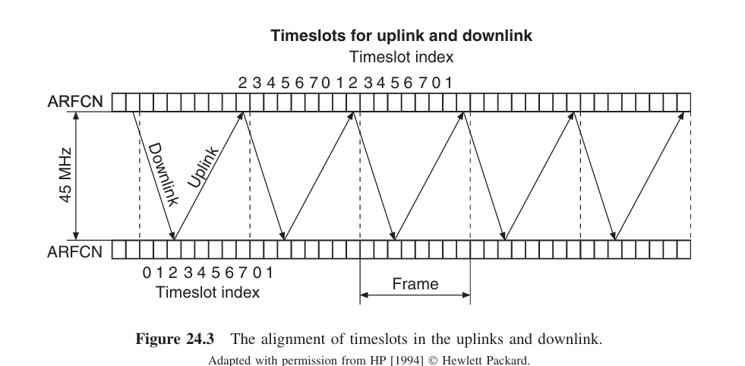
The Assignment of Timeslots in the Uplink and Downlink

Slide 44
Modulation Technique – GMSK
Gaussian Minimum Shift Keying (GMSK) is used for GSM downlink.
Variant of Minimum Shift Keying (MSK) with Gaussian filtering.
Time-bandwidth product BGT = 0.3.
Advantages:
Narrow spectrum efficiency.
Disadvantages:
Causes Inter Symbol Interference (ISI).
Equalization is required to combat delay dispersion.
Detection methods:
Differential detection
Coherent detection
Limiter–discriminator detection

Slide 45
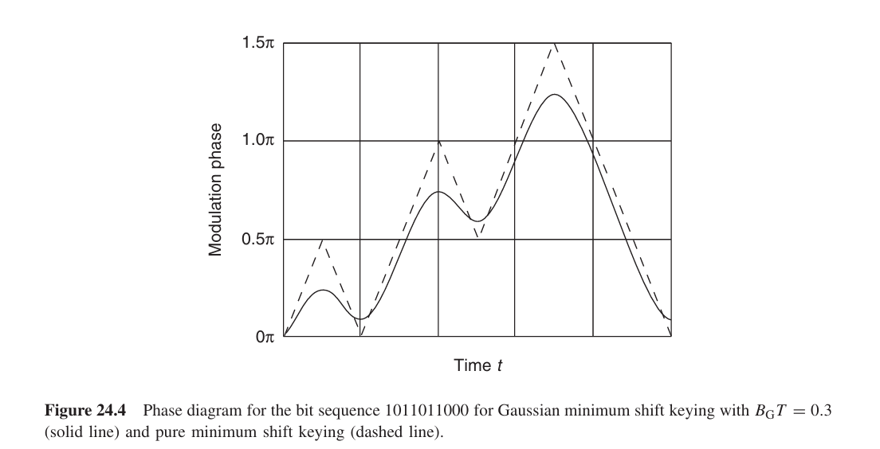

Slide 46
Power Ramping in GSM
Why Power Ramping?
Prevents abrupt signal transitions that cause spectral broadening.
Ensures smooth transmission start and stop.
How it Works?
Signals are gradually turned on and off.
Defined ramp-up time: 28μs.
Power increases from 2 × 10⁻⁷ W to 2W.
During Transmission:
Power deviation limited to ±1dB (25%) from nominal value.
Ensures stable signal transmission.

Slide 47
Signal Power and Power Control in GSM
Purpose of Power Control:
Battery Efficiency: Reduces MS power consumption and extends battery life.
Interference Reduction: Prevents unnecessary interference in adjacent cells.
GSM vs. CDMA:
Power control is essential in CDMA.
In GSM, it optimizes performance but is not mandatory.

Slide 48
Power Control Mechanism in GSM
Mobile Station (MS) Power Control:
Maximum transmission power: 2W (common for MSs).
Can be reduced by 30dB, in 2dB steps.
Adaptive control: BS informs MS about received signal level.
Base Station (BS) Power Control:
Max power varies: 2W to 300W+.
Power can also be reduced by 30dB.
Adjustments help optimize network efficiency.

Slide 49
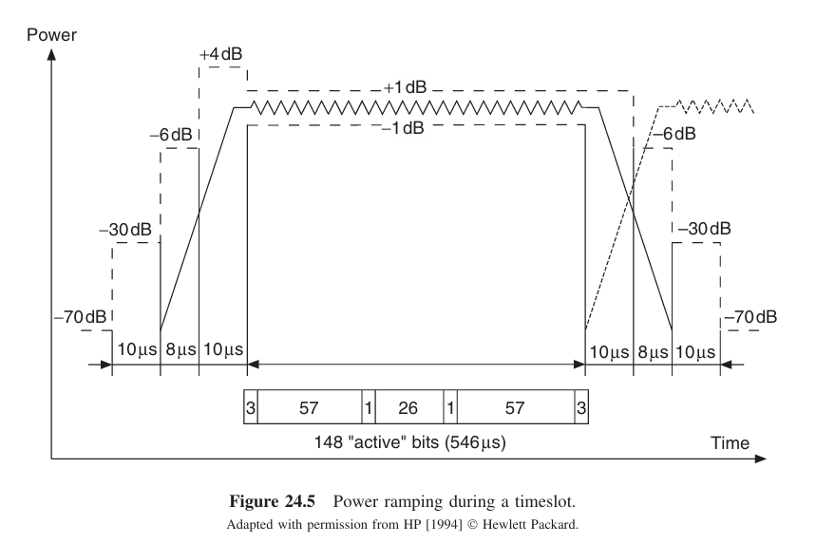

Slide 50
Out-of-Band Emission and Intermodulation Products
Out-of-Band Emission Limits:
Less strict than analog systems.
Max permitted out-of-band power: ~−30dBm (BS & MS).
High value for wireless communication.
Uplink Band Restrictions (890–915MHz):
BS emissions must not exceed −93dBm.
Needed to prevent interference with MS signals (~−102dBm).
BS transmit and receive antennas are close, making interference critical.
Intermodulation Products:
Similar strict limits apply.
Ensures minimal disruption to signal reception and network performance.

Slide 51
Structure of a GSM Timeslot
Types of GSM Bursts
Normal Burst: Used for regular data transmission.
Access Burst:
Transmitted by MSs to establish initial contact with BS.
Frequency Correction Burst:
Helps MSs adjust to the correct frequency.
Synchronization Burst:
Enables MSs to synchronize with BS frame timing.
Timeslot Length: 148 bits
Data Structure:
Payload Data: Two blocks of 57 bits each.
Midamble (26 bits):
Used for training equalization.
Serves as BS identifier.
Control Bits:
Located between the midamble and data blocks.
Purpose explained in Section 24.4.
Tail Bits (3 bits at start & end):
Helps with Maximum Likelihood Sequence Estimation (MLSE).
Guard Period (8.25 bits): Prevents interference between timeslots.

Slide 52
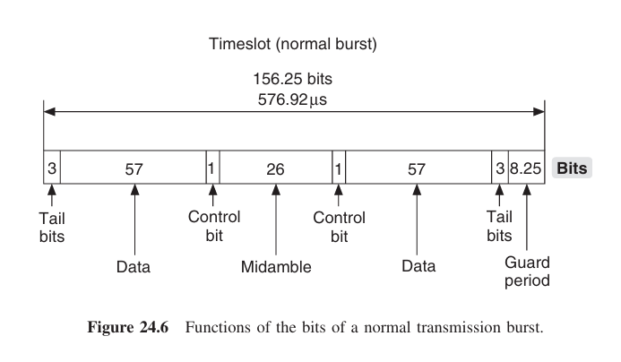

Slide 53
4.Logical and Physical Channels Overview

Slide 54
4.Logical and Physical Channels Overview
Definition: Logical channels manage different types of data transmission, mapped onto physical channels (specific timeslots on a frequency band).
Two Main Channel Types:
Traffic Channels (TCHs): Transmit payload data (voice or pure data).
Control Channels (CCHs): Transmit signaling information required for network operation.
Logical Channel Mapping: Logical channels are mapped onto physical channels based on timeslot allocation.

Slide 55
Traffic Channels (TCHs)
Full-Rate Traffic Channels (TCH/F):
Full-rate voice: 13 kbit/s (channel-coded to 22.8 kbit/s).
Full-rate data: Supports 9.6, 4.8, or 2.4 kbit/s (coded to 22.8 kbit/s).
Half-Rate Traffic Channels (TCH/H):
Half-rate voice: 6.5 kbit/s (channel-coded to 11.4 kbit/s).
Half-rate data: 4.8 or 2.4 kbit/s (coded to 11.4 kbit/s).
Efficiency: Two half-rate channels can share the same timeslot in alternating frames.

Slide 56
Control Channels (CCHs)
Broadcast Channels (BCHs) (Downlink Only):
FCCH (Frequency Correction Channel): Provides MS with frequency reference.
SCH (Synchronization Channel): Helps MS synchronize to BS timing.
BCCH (Broadcast Control Channel): Transmits cell-specific information.
Common Control Channels (CCCHs):
PCH (Paging Channel): Alerts MS for incoming calls.
RACH (Random Access Channel): MS requests connection.
AGCH (Access Grant Channel): Assigns a dedicated channel for communication.

Slide 57
Dedicated Control Channels (DCCHs)
SDCCH (Standalone Dedicated Control Channel): Manages authentication and call setup.
SACCH (Slow Associated Control Channel): Transmits link-quality information.
FACCH (Fast Associated Control Channel): Used for quick handovers (HOs).
Association:
SACCH is linked to either a TCH or an SDCCH.
FACCH is linked only to a TCH.

Slide 58
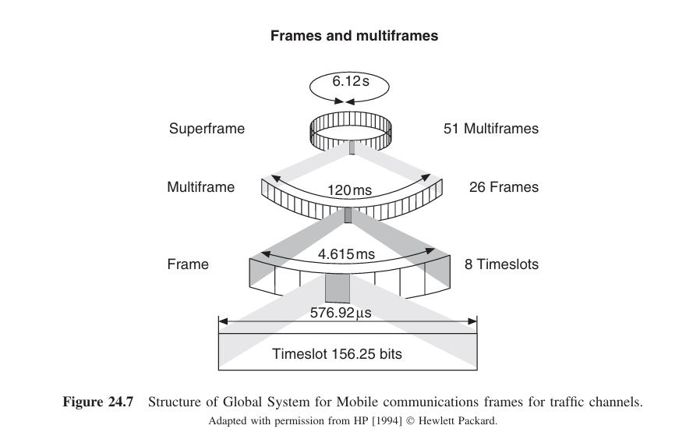
Mapping Between Logical and Physical Channels

Slide 59
Understanding the Frame Structure
GSM time grid is divided into periodically repeated frames and timeslots.
Frames are the smallest unit of time, with 8 timeslots per frame.
Frame Hierarchy:
1 Frame = 8 timeslots (4.61ms)
26 Frames = 1 Multiframe (120ms)
51 Multifames = 1 Superframe (6.12s)
2,048 Superframes = 1 Hyperframe (3h 28min)
Purpose of Hyperframe: Mainly for encryption and privacy over the air interface.

Slide 60
Logical Channels in a Multiframe
Traffic Channel (TCH) and SACCH
TCH: 24 out of 26 frames used for TCH data transmission.
SACCH:
Uses the 13th frame (and sometimes the 26th) of the multiframe.
Transmission rate: 950 bit/s.
Data processing:
Four SACCH bursts are grouped into a 480ms frame.
Uses convolutional encoding to ensure error correction.
FACCH
Only used in special situations (e.g., handover).
No dedicated timeslot; instead, it “steals” bits from the TCH bursts.
Uses the same encoding method as SACCH.

Slide 61
Common Logical Channels
1.BCCH Carrier
Some logical channels are not associated with a TCH and require separate transmission.
These channels are mapped to timeslot 0 of the BCCH carrier.
If the cell is full, this timeslot can be used for a TCH connection.
Frames are combined differently:
51 frames = 1 Multiframe (235ms)
2.RACH (Random Access Channel)
Used in uplink only.
Access Burst Structure:
8 tail bits → 41 sync bits → 36 encoded data bits → 3 tail bits.
Guard time of 100μs to avoid collision.
Timeslot 0 can be used for random access bursts in every frame.

Slide 62
Common Channels in the Downlink
FCCH, SCH, BCCH, PCH, and AGCH
Found in downlink only and have a fixed order in the multiframe.
Multiframe Structure:
51 frames, with the last frame always idle.
Divided into blocks of 10 frames:
1st frame: FCCH
2nd frame: SCH
Frames 3-6: BCCH
Frames 7-10: PCH or AGCH
SDCCH (Standalone Dedicated Control Channel)
May have a separate physical channel or use available BCCH slots.
Either four or eight SDCCHs can share one physical channel.

Slide 63
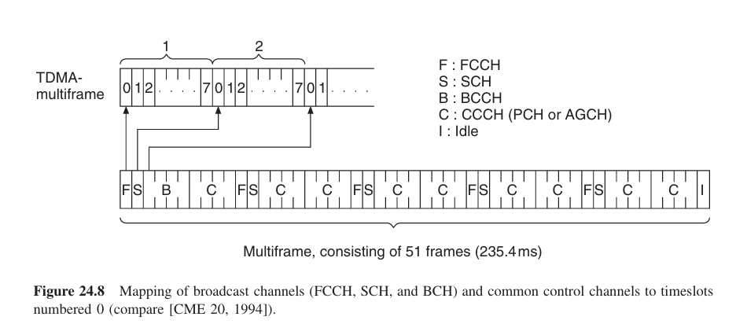

Slide 64
5. Synchronization in GSM

Slide 65
5. Synchronization in GSM
The MS synchronizes with the BS for both frequency and time.
Steps for synchronization:
Frequency Synchronization – Adjusting the MS frequency to match the BS.
Time Synchronization – Aligning timing with the BS's signal.
Timing Advance – Compensating for signal travel time.

Slide 66
Frequency Synchronization
The BS uses high-precision clocks (Rubidium or GPS signals).
The MS uses low-cost quartz oscillators.
The FCCH (Frequency Correction Channel) transmits the reference frequency.
The FCCH burst consists of:
3 tail bits at start and end.
142 all-zero bits in the middle.
Guard period eq. to period of 8.25 bits.
The MS adjusts its local oscillator based on the FCCH signal.

Slide 67
Time Synchronization & Timing Advance
Time Synchronization:
Done via the SCH (Synchronization Channel).
SCH transmits frame and timing information.
Helps MS align its internal counter with BS.

Slide 68
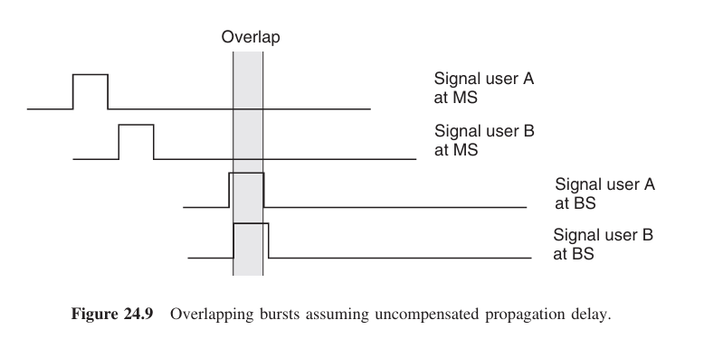
Timing Advance:
Required due to signal delay (up to 100μs for 30km range).
The BS estimates delay and instructs the MS to send bursts earlier.
Prevents overlapping of bursts from different MSs.

Slide 69
Summary of Burst Structures
GSM supports different burst structures:
FCCH Burst – Frequency synchronization.
SCH Burst – Time synchronization.
RACH Burst – Access request with extended guard time.
Normal Burst – Used for standard data transmission.
Guard periods ensure bursts don’t overlap at the BS.
In large cells, every second timeslot may be used to prevent interference.

Slide 70
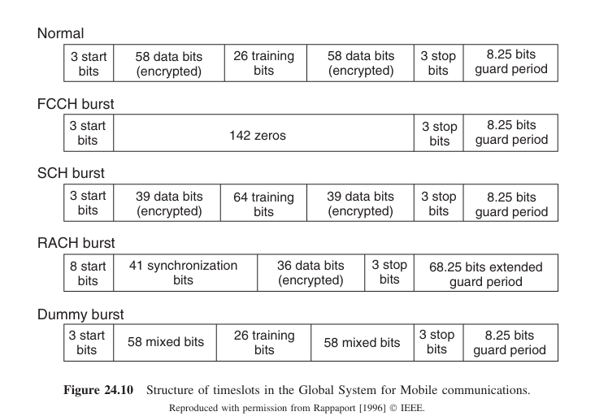

Slide 71
6.Coding in GSM

Slide 72
6.Coding in GSM
Purpose: Convert speech into a digital signal while maintaining quality and minimizing data rate.
Key Processes:
Voice Encoding – Compressing speech data efficiently.
Channel Encoding – Adding redundancy for error correction.
Cryptography – Encrypting data for security.
Frequency Hopping – Mitigating interference and fading.

Slide 73
Voice Encoding in GSM
Uses lossy compression (RPE-LTP method).
Speech modeled as a time-varying filter bank.
The encoder transmits:
Filter parameters
Excitation parameters
Bit classification:
Class 1a: Most important, protected by block & convolutional coding.
Class 1b: Moderately important, protected by convolutional coding.
Class 2: Least important, no protection.
Voice Activity Detection (VAD) & Discontinuous Transmission (DTX)
Reduces data rate when no speech is detected.
Saves battery and reduces interference.

Slide 74
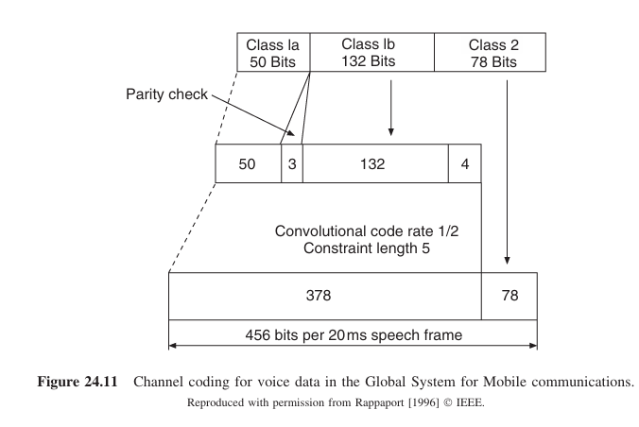
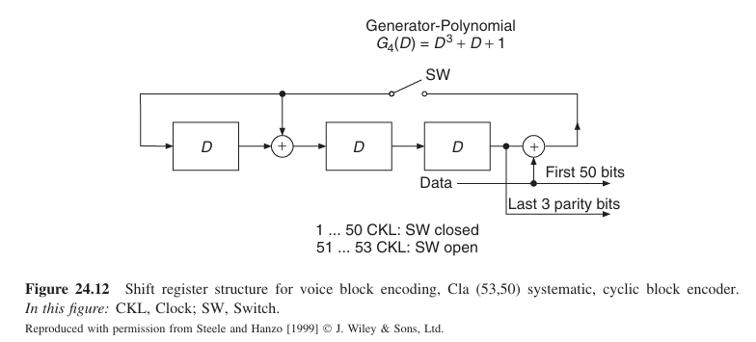
Channel Encoding in GSM
Block Coding:
Class 1a bits use a (53,50) block code for error detection.
If an error is detected, the block is discarded, and a replacement is estimated.

Slide 75


Fire Code for Signalling Data:
(224,184) Fire code corrects burst errors.
More redundancy due to critical importance (e.g., handovers).
Convolutional Encoding:
Rate-1/2 convolutional coding applied to Class 1 bits & signaling data.
Uses generator polynomials:

Slide 76
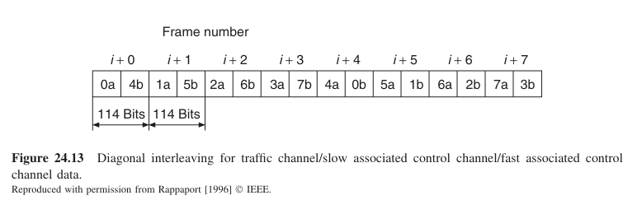
Interleaving in GSM
Purpose: Spread out burst errors caused by fading.
Method:
Data from two blocks ("a" and "b") is interleaved.
Each block is split into 8 subblocks.
Subblocks are transmitted in separate bursts.
Diagonal Interleaving:
Each transmission burst contains parts of two different blocks.
Reduces the impact of deep fades.

Slide 77
Cryptography in GSM
Why is encryption needed?
Analog mobile communication was easy to eavesdrop on.
Digital systems can apply cryptographic techniques for security.
Encryption Process:
Uses XOR operation with a Pseudo Noise (PN) sequence.
The PN-sequence has a 3.5-hour periodicity.
The A5 algorithm is used for encryption.
A3 & A8 algorithms handle authentication.
Security Challenges:
Reverse engineering of encryption algorithms has occurred.
However, attacks require significant effort and resources.

Slide 78
Frequency Hopping in GSM
Purpose: Reduce interference and fading effects.
How it works:
Carrier frequency changes for each transmission burst.
Requires hopping pattern synchronization between BS & MS.
Benefits:
Reduces impact of small-scale fading.
Mitigates co-channel interference.
Helps spread interference more evenly.
Limitations:
Not applied to BCH & CCCH channels to ensure easy detection by the MS.

Slide 79
7.Equalization in GSM

Slide 80
7.Equalization in GSM
Why is Equalization Needed?
GSM symbols are shorter than typical channel delay spreads, leading to Inter-Symbol Interference (ISI).
Equalization corrects ISI and improves signal quality.
Training Sequence for Equalization:
26-bit midamble used for channel estimation.
Located in the middle of a burst (57 bits before & after).
Eight different PN-sequences are defined to help distinguish between cells.
Channel Estimation:
The training sequence has an autocorrelation peak of 26 at zero offset.
Cross-correlation with the received midamble provides a scaled version of the channel impulse response.
The estimated impulse response is used to correct ISI for all symbols in a burst.

Slide 81
Viterbi Equalization & Delay Diversity
Why Midamble Instead of Preamble?
GSM supports MS speeds up to 250 km/h.
If training was at the start of the burst, channel variations would make it inaccurate by the end.
Midamble ensures accuracy for the entire burst.
Viterbi Equalization:
Most common equalizer used in GSM.
Based on a trellis structure to track channel memory (constraint length).
Balances performance and complexity.
Works well with convolutional decoding.
Delay Diversity:
Multipath propagation leads to versions of the signal arriving at different times.
Different paths fade independently, reducing average bit error probability.
Multipath effects can improve reliability with a proper equalizer.

Slide 82
8.Circuit-Switched Data Transmission in GSM

Slide 83
8.Circuit-Switched Data Transmission in GSM
Initial Focus on Voice Communication
GSM was designed primarily for voice calls.
Some data services were included:
Short Message Service (SMS)
Point-to-point data transmission (9.6 kbps)
Data transmission used a circuit-switched mode, similar to voice calls.
Disadvantages of Circuit-Switched Data (CSD)
Low data rate (below 10 kbps).
Slow connection setup time.
High cost for maintaining a continuous connection.
Poor match for Internet-based applications, which require burst transmissions.

Slide 84
Transition to Packet-Switched Data
Mismatch with Modern Web Applications
Web browsing, email, and multimedia require higher data rates.
CSD’s continuous connection model was inefficient for bursty traffic.
Only SMS remained widely used.
Introduction of Packet-Switched Transmission
GSM later introduced packet-switched (connectionless) data transmission.
Improved efficiency for high-volume, intermittent data needs.
GPRS (General Packet Radio Service) and later EDGE provided better data rates.
Became the foundation for mobile internet evolution.

Slide 85
9. Establishing a Connection and Handover in GSM

Slide 86
9. Establishing a Connection and Handover in GSM GSM Identity Numbers
1. Mobile Station ISDN Number (MS ISDN)
The unique phone number of the subscriber.
Structure:
Country Code (CC)
National Destination Code (NDC)
Subscriber Number
Maximum 15 digits.
3. Mobile Station Roaming Number (MSRN)
Temporary number for roaming subscribers.
Helps in call routing outside the home network.
4. International Mobile Station Equipment Identity (IMEI)
Identifies the mobile device itself.
Structure:
Type Approval Code (TAC)
Final Assembly Code (FAC)
Serial Number (SN)
IMEI is not linked to a subscriber but to the hardware.
2. International Mobile Subscriber Identity (IMSI)
Used for subscriber identification in the GSM network.
Structure:
Mobile Country Code (MCC)
Mobile Network Code (MNC)
Mobile Subscriber Identification Number (MSIN)
Stored in the Subscriber Identity Module (SIM).

Slide 87
Mobile Subscriber Identification in GSM
SIM Card – Key to Subscriber Identity
The SIM card contains:
IMSI for subscriber authentication.
Temporary network information (e.g., TMSI, location area).
User profile data (e.g., phonebook).
Security Mechanisms
Personal Identification Number (PIN)
A 4-digit code required at phone startup (if activated).
If entered incorrectly 3 times, the SIM is locked.
Can be reset using the Personal Unblocking Key (PUK).
Personal Unblocking Key (PUK)
Unlocks the SIM if the PIN is blocked.
10 incorrect attempts result in permanent SIM lock.
Key Features of SIM Cards
A GSM phone requires a SIM to make/receive calls.
Calls are billed to the subscriber whose SIM is in the device.
A subscriber can use any compatible phone by inserting their SIM.

Slide 88
Connection Establishment & Handover in GSM
Establishing a Connection
The network identifies the mobile using:
IMSI, MSRN, or TMSI (Temporary Mobile Subscriber Identity).
A paging request is sent to locate the MS.
Once found, the network assigns radio resources to establish the call.
Handover Process
Handover occurs when a user moves between cells.
The mobile continuously monitors signal strength.
Types of handovers:
Intra-cell: Between frequencies within the same cell.
Inter-cell (same BTS): Between sectors of the same Base Station.
Inter-BTS (same BSC): Between different Base Stations under one BSC.
Inter-BSC (same MSC): Between different BSCs in the same MSC.
Inter-MSC: Between different MSCs (more complex process).

Slide 89
Example of Establishment of a Connection in GSM:
Mobile-Initiated Call Setup
Steps for Call Establishment by a Mobile Subscriber
MS requests SDCCH from BTS using RACH.
BTS grants access via AGCH.
MS sends connection request to MSC via SDCCH:
Provides the dialed number.
Performs authentication.
MSC marks MS as busy.
MSC assigns a Traffic Channel (TCH) via BSC.
MSC establishes a connection to the external network (PSTN).
If the called party answers, the connection is established.

Slide 90
Network-Initiated Call Setup
Steps for Call Establishment to a Mobile Subscriber
A PSTN user dials the MS ISDN (mobile number).
The PSTN routes the call to the GSM provider’s Gateway MSC.
The Gateway MSC queries the HLR for the subscriber’s location.
If roaming, HLR requests the MSRN from the current MSC.
The Gateway MSC forw
ards the call to the hosting MSC.
The hosting MSC locates the MS in its area via the BSC.
BSC pages the MS via BTSs in the location area.
MS responds by requesting an SDCCH.
BSC grants access via AGCH.
Connection setup follows the same process as an MS-initiated call.
If the MS answers, the call is connected.

Slide 91
10.GSM Services and Billing:

Slide 92
GSM Services Overview
1. Teleservices (End-to-End Communication)
Voice Calls – Standard mobile calls.
DTMF (Dual-Tone Multi-Frequency) – Keypad-based signaling (e.g., remote access to voicemail).
Emergency Calls – Priority access even without a SIM.
FAX – Requires adapters due to GSM’s digital nature.
SMS (Short Message Service) – Text messages (up to 160 characters).
Cell Broadcast – Localized public messaging (e.g., traffic updates).
Voicemail – Call forwarding to an answering service.
Fax Mail – Faxes stored in a GSM service center.
2. Bearer Services (Network Access)
PSTN Connection – Dial-up access to analog landlines.
ISDN Connection – Digital network connectivity.
Packet-Switched Networks – Enables mobile data transmission.

Slide 93
Supplementary Services & Billing
Supplementary Services (Call Management & Security)
Call Forwarding – Redirects calls based on conditions.
Call Blocking – Restricts outgoing/incoming calls (e.g., international calls).
Advice of Charges – Estimates call costs.
Call Hold & Waiting – Manage multiple calls simultaneously.
Conference Calls – Allows multi-user voice calls.
Caller ID – Displays the caller’s number.
Closed User Groups – Limits calls within predefined groups.

Slide 94
Billing
1. Technical & Economic Challenge – Requires an Operations Support System (OSS) for accurate billing. 2. Flexible Payment Models – Unlike traditional landlines, GSM allows shared costs between caller and receiver. 3. Accounting for Supplementary Services – Charges for call forwarding, roaming, SMS, data usage, etc., are tracked separately.
OSS ensures accurate billing & service management for diverse subscriber plans.

Slide 95
Assignment:
Examples of Different Kinds of Handovers
3 cases are discussed in the text , prepare a report on that.
Examples of Billing is discussed in text , go through it.

Slide 96
E-learning links:GSM
https://youtu.be/-HWRBlPcGXI?feature=shared
https://youtu.be/6pqELic7Ewc?feature=shared
https://youtu.be/7khxg0JUwyU?feature=shared
https://youtu.be/oNRxTKlqHvs?feature=shared

Slide 97
IS-95 &
CDMA 2000

Slide 98
CONTENTS
Historical Overview
System Overview
Air Interface
- Frequency Bands and Duplexing
- Spreading and Modulation
- Power Control
- Pilot Signal
4. Coding
-Speech Coders
-Error Correction Coding
5. Spreading and Modulation
-Long and Short Spreading Codes and Walsh Codes
-Spreading and Modulation in the Uplink
-Databurst Randomization and Gating for the Uplink
-Spreading and Modulation in the Downlink
6. Handover

Slide 99
1. Historical Overview
Evolution of CDMA: From IS-95 to 3G Standards
Key Milestones
1991: Qualcomm’s IS-95 became the first commercial CDMA standard (adopted by TIA).
Post-1992: U.S. operators shifted from analog (AMPS) to digital (IS-95 gained traction).
Late 1990s: Demand for high-data-rate applications (streaming, web) drove 3G development.

Slide 100
3G CDMA Standards
CDMA2000 (U.S./IS-95 legacy):
Backward-compatible with IS-95.
Seamless transition for existing operators.
WCDMA (GSM legacy):
Adopted by GSM-based operators.
Incompatible with CDMA2000 despite similarities.
Market Impact
Dominant in South Korea; used by 2/4 major U.S. operators by 2005.

Slide 101
2. IS-95 System Overview
Frequency Allocation & Duplexing
FDMA Component: 1.25 MHz bands per channel.
U.S. Spectrum:
Uplink: 1850–1910 MHz
Downlink: 1930–1990 MHz
Duplexing: Frequency Division Duplex (FDD).
Channel Structure & Spreading
Channels Separated by Codes: Traffic, control, pilot use unique chip sequences.
Speech Coding: 13.3 or 8.6 kbit/s → encoded to 28.8 kbit/s.
Spreading Factor: 64 → Chip rate = 1.2288 Mchip/s.
Theoretical Users/Cell: 64 (practical: 12–18 due to interference/power control).

Slide 102
Key Features
Downlink: Walsh-Hadamard codes (orthogonal, max 64 channels).
Uplink: Non-orthogonal codes + inter-cell interference.
Power Control:
BS: 8–50 W (adjustable coverage).
MS: ~200 mW (tight power control for equal received power).
Synchronization: GPS timing for BSs (eases handovers).

Slide 103
3. AIR INTERFACE 1. Frequency Bands and Duplexing
Uplink and Downlink Separation: Utilizes FDD for simultaneous communication.
Frequency Bands
Operating Band: 1850–1990 MHz (Personal Communication System - PCS band).
Channel Width: Divided into 50 kHz units.
Channel Frequency Calculations
Uplink Frequencies:
Downlink Frequencies:
where nch = 1,...,1199. An IS-95 system requires 1.25MHz– i.e., 25 of these channels

Slide 104
2. Spreading and Modulation
Source Data Rate:
Rate-set 1: 8.6 kbit/s
Rate-set 2: 13.3 kbit/s
Chip Rate: 1.2288 Mchip/s
Spreading Techniques:
M-ary Orthogonal Keying (MOK):
Used to spread the data over multiple orthogonal channels.
Multiplication by Spreading Sequences:
Uses Pseudo-Noise (PN) codes to spread the signal across a wide bandwidth.

Slide 105
3. Power Control
Power control is critical for maintaining the capacity and performance of a CDMA cellular system.
It compensates for both large-scale fading and Small-Scale Fading (SSF).
Quality of Power Control:
Accuracy: Measures the deviation of received power from the ideal level in steady-state conditions.
Speed: Determines how quickly power control adapts to changing channel conditions.

Slide 106
1. Open-Loop Power Control:
The Mobile Station (MS) observes downlink power, estimates path loss, and adjusts transmit power.
Compensates for shadowing and average path loss, but not SSF.
Used at the start of a call when no closed-loop control is available
2. Closed-Loop Power Control:
Inner Loop:
BS adjusts MS power based on SINR (Signal-to-Interference-and-Noise Ratio) every 1.25ms.
Command to MS: Adjust power by ±1 dB.
Outer Loop:
BS evaluates uplink performance via frame quality.
If the frame error rate is high, SINR target is adjusted every 20ms.

Slide 107
4. Pilot Signal
Purpose: Timing acquisition, channel estimation, and handover process support.
Pilot Signal Characteristics:
Pseudo Noise (PN)-Sequence with 32,768 chips (26.7ms long).
Pilots from different Base Stations (BSs) are offset by 64 chips (52.08μs), reducing interference from long-delayed echoes.
Usage by MS (Mobile Station):
MS correlates received signal with pilot PN-sequence.
Enables MS to determine signal strength from all BSs in its vicinity.

Slide 108
4. CODING
Before a speech signal can be transmitted over the air interface, it first has to be digitized and encoded.
IS-95 foresees the use of different speech coders with different bit rates
It has to be designed in such a way that output from the channel coder is always 19.2 kbit/s for the downlink and 28.8 kbit/s for the uplink

Slide 109
1. Speech Coders
Initial Coder: IS-96A
Bit Rate: 8.6 kbit/s
Issue: Poor speech quality, degraded with increased frame error rates.
CDG-13 Vocoder (QCELP)
Variable-rate speech coder
Dynamic Bit Rates: 13.3, 6.2, 1, and possibly 2.7 kbit/s based on voice activity.
Frame Duration: 20 ms
Parameters: Formant, pitch, and codebook determined via “analysis by synthesis.”
Complexity Factors:Intensive computational demands for parameter search.

Slide 110
Enhanced Variable Rate Coder (EVRC)
Active Bit Rate: 170 bits per 20 ms
Features: Adaptive noise suppression, improved speech quality.
Variable Data Rate Advantage:
Reduced to ~1 kbit/s during silence (approx. 50% of the time), increasing overall capacity.

Slide 111
2. Error Correction and Coding Error Correction Coding for 8.6 kbit/s Uplink
Forward Error Correction Overview:
Different for 8.6 kbit/s vs. 13.3 kbit/s.
Identical for IS-96A and EVRC vocoders (Rate-Set-1).
Encoding Steps:
Initial Bits: 172 bits from vocoder for each 20 ms frame.
Add Frame Quality Indicator (FQI):
12 bits added as parity check bits.
Encoder Tail:
8-bit tail added, totaling 192 bits.
Convolutional Encoding:
Encoded with a rate-1/3 convolutional encoder (constraint length 9).
Generator Polynomials:
G1(D) = 1 + D² + D³ + D⁵ + D⁶ + D⁷ + D⁸
G2(D) = 1 + D + D³ + D⁴ + D⁷ + D⁸
G3(D) = 1 + D + D² + D³ + D⁴ + D⁵ + D⁸
Final Bit Rate:
Increases to 28.8 kbit/s after encoding.

Slide 112
Error Correction Coding for 13.3 kbit/s Uplink
Similar encoding steps to the 8.6 kbit/s vocoders but with different values.
Encoding Steps:
Initial Bits: 267 bits (including unused bits) per 20 ms frame.
Add Frame Erasure Bit: Indicates frame status.
Add Frame Quality Indicator (FQI):
12 bits to check frame integrity.
Add Encoder Tail:
8-bit tail for Viterbi decoder assistance.
Total Bits: 288 bits per 20 ms frame.
5. Convolutional Encoding:
Encoded with a rate-1/2 convolutional encoder (constraint length 9).
Generator Polynomials:
G1(D) = 1 + D + D² + D³ + D⁵ + D⁷ + D⁸
G2(D) = 1 + D² + D³ + D⁴ + D⁸

Slide 113
Error Correction Coding in the Downlink
Error Correction Coding for 8.6 kbit/s Downlink
Similar FQI and tail bits as uplink.
Uses a rate-1/2 convolutional encoder.
Bit Rate:
Increases to 19.2 kbit/s.
Error Correction Coding for 13.3 kbit/s Downlink
Follows the 13.3 kbit/s uplink procedure.
Bit Rate:
Initial rate: 28.8 kbit/s.
Puncturing applied to achieve 19.2 kbit/s.
Interpretation:
Encodes vocoder output using a rate-3/4 convolutional code.
Puncturing eliminates the 3rd and 5th bits from 6-bit symbol blocks.
Preserves all bits from G1(D) while selectively removing bits from G2(D).

Slide 114
Interleaving
Output from the convolutional encoder is sent through a block interleaver of length 576 for rate set 2.

Slide 115
5. SPREADING AND MODULATION

Slide 116
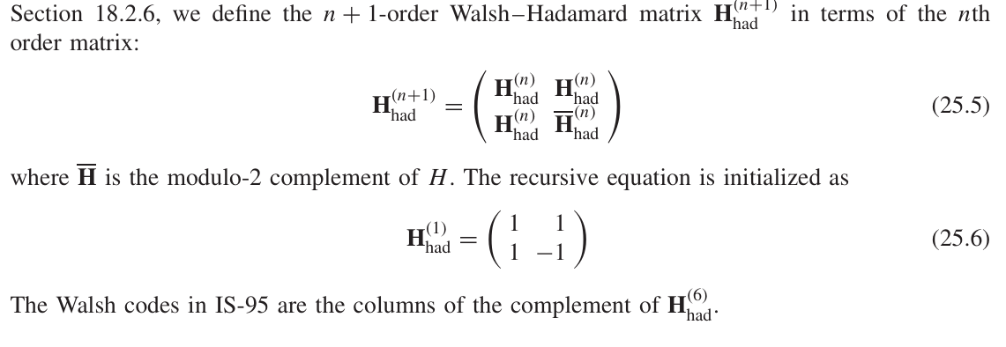
1. Long and Short Spreading Codes and Walsh Codes
IS-95 uses three types of spreading codes: long spreading codes, short spreading codes, and Walsh codes.
Walsh Codes
Strictly orthogonal codes constructed systematically.
Walsh–Hadamard Matrix:

Slide 117
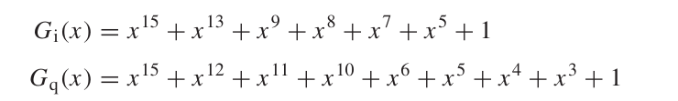
Short Spreading Codes
PN-Sequences:
Generated using a shift register of length 15.
Periodicity: 215−12^{15} - 1215−1.
Adjusted Periodicity: 215=32,7682^{15} = 32,768215=32,768 chips (26.7 ms).
Generator Polynomials:

Slide 118
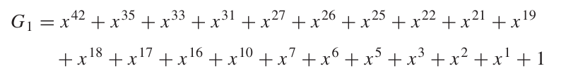
Long Spreading Codes
Definition: Based on PN-sequences for longer periodicity.
Shift Register Length: 42 bits.
Periodicity: 242−12^{42} - 1242−1 (over 40 days).
Generator Polynomial

Slide 119
Modulation: Output from the shift register is modulo-2 added with a long-code mask.
Channel Variations:
Access Channels: Derived from paging and access channel numbers and BS identification.
Traffic Channels: Derived from Electronic Serial Number (ESN) or encryption algorithm.

Slide 120
2. Spreading and Modulation in the Uplink
Modulation and coding in the uplink are achieved through a combination of steps. The starting point is a bitstream with 28.8 kbit/s, which is obtained by providing error correction coding to the vocoder signal

Slide 121
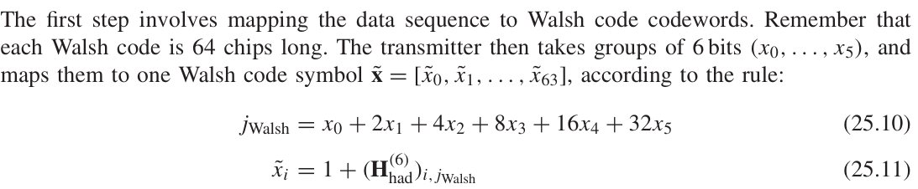
Step 1: Mapping Data to Walsh Code
Achieves spreading by a factor of 64/6
Chip Rate: Output from Walsh encoder at 307.2 kchip/s
This can also be seen as M-ary orthogonal modulation; in other words, each group of 6 bits is represented by one modulation symbol that is orthogonal to all other admissible modulation symbols.

Slide 122
Step 2: Spreading with Long Code
Long Spreading Code: Multiplies Walsh code output.
Uplink Functionality: Provides channelization, distinguishing different traffic and access channels.
Chip Rate: Increases to 1.2288 Mchip/s.
Step 3: Separation and Modulation
Data stream separated into In-phase (I) and Quadrature-phase (Q) components.
Each component multiplied by short spreading sequences (no change in chip rate).
Uses Offset Quadrature Amplitude Modulation (OQAM).

Slide 123
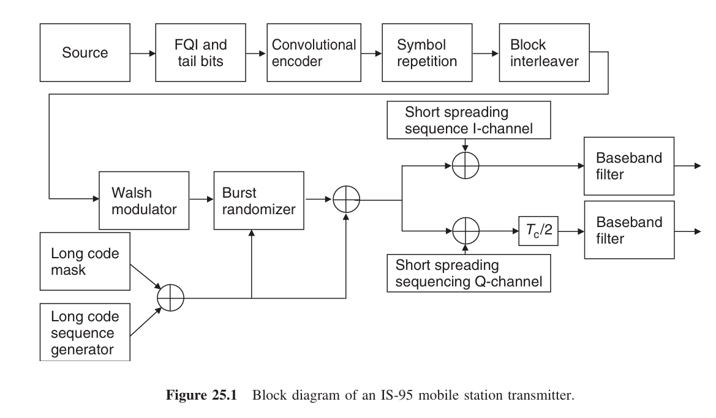

Slide 124
1. Source Data Preparation
Bitstream Rate: Starts with a 28.8 kbps bitstream, which is the vocoder output with error correction coding applied.
This stream carries voice or data that will be transmitted over the air.

Slide 125
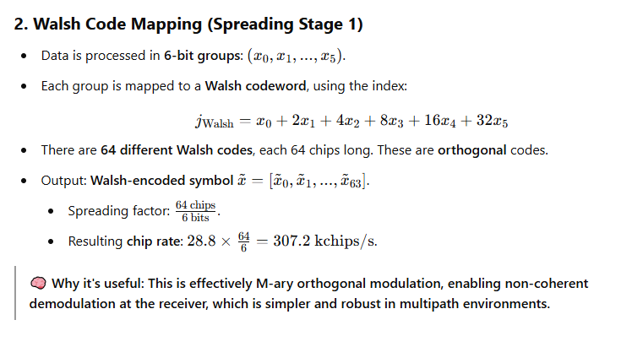

Slide 126
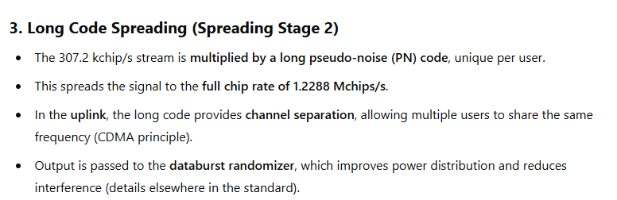

Slide 127
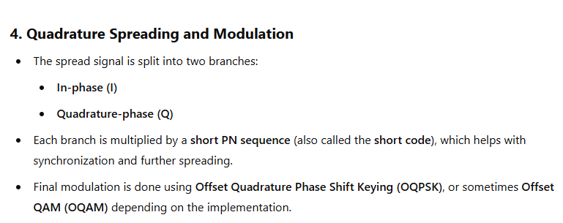

Slide 128
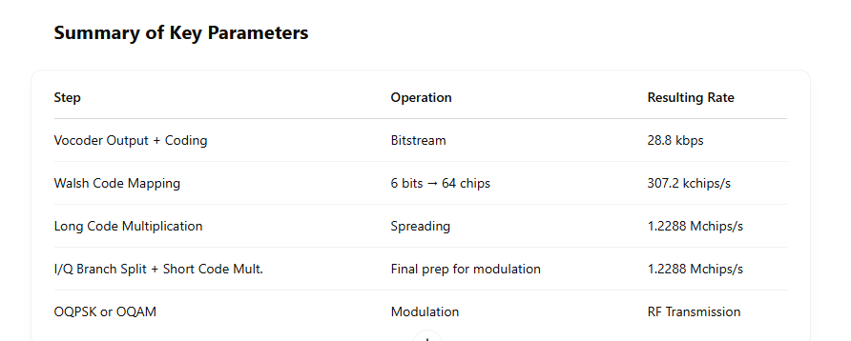

Slide 129
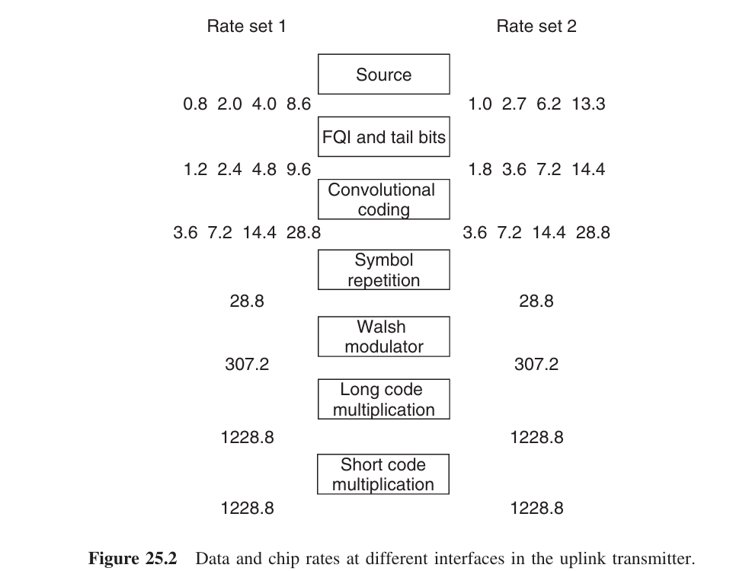

Slide 130
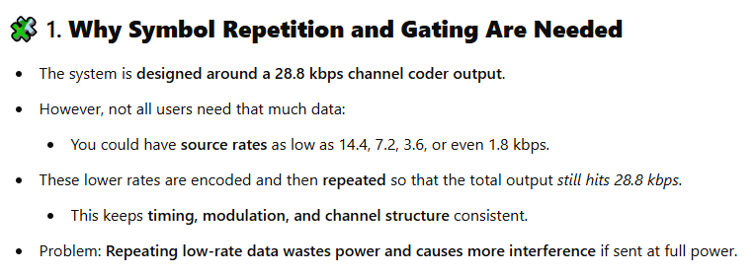

Slide 131
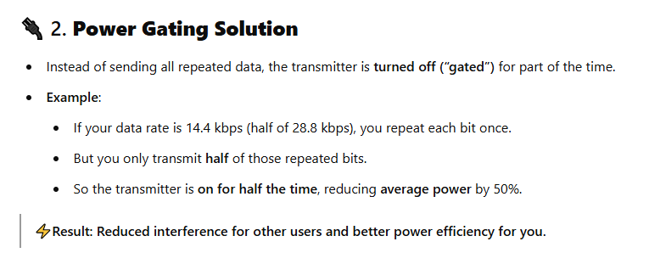

Slide 132
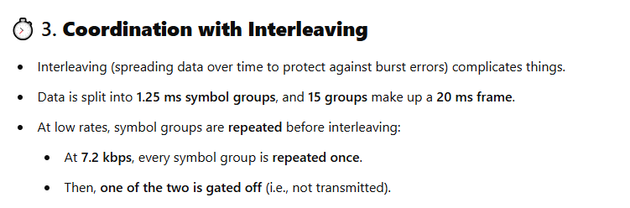

Slide 133
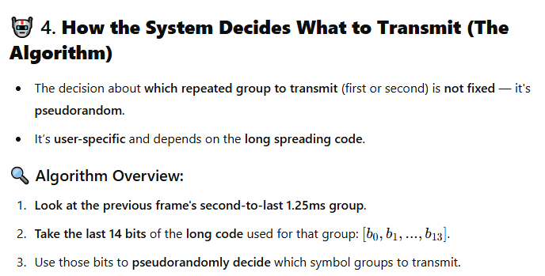

Slide 134
3. Databurst Randomization and Gating for the Uplink
Standard Data Rate: 28.8 kbit/s output from the channel coder.
Source Rates:
14.4 kbit/s or 9.6 kbit/s
Lower rates: 14.4 kbit/s, 7.2 kbit/s, 3.6 kbit/s possible through convolutional encoding.
Repeating Symbols: Encoded symbols repeated to achieve desired data rate.
Gating Mechanism
Purpose: Optimize power usage by transmitting repeated data only part of the time.
Transmitter Operation:
Example: For 14.4 kbit/s (source 7.2 kbit/s), transmitter active only 1/2 the time.
Result: Average transmit power reduced by half, lowering interference for other users.

Slide 135
Gating Coordination with Interleaver
Timing: Gating must align with interleaver output.
For 7.2 kbit/s source rate, each 1.25 ms symbol group is repeated.
Gating removes one of the two symbol groups.
Gating Decision Algorithm
A decision about which of two symbol groups actually gets transmitted is determined by the long spreading sequence, according to the following algorithm
Analyze the second-to-last 1.25 ms symbol group.
Use the last 14 bits of the sequence, labeled as [b0, b1, ..., b13].

Slide 136
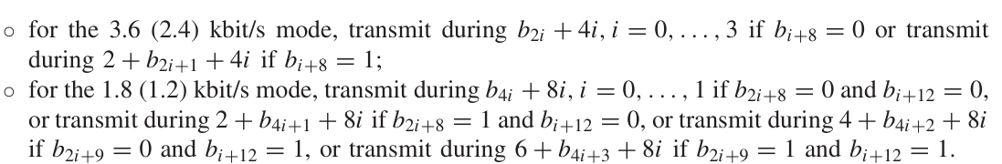
3. Transmission Rules:
14.4/9.6 kbit/s: Always transmit.
7.2/4.8 kbit/s: Transmit first group if bi=0, i​=0 (i = 0,...,7); otherwise, transmit second.
Benefits of Pseudorandom Gating
Interference Management: Different gating for each user helps "smear out" interference, ensuring that users do not experience simultaneous interference from all other users.

Slide 137
4. Spreading and Modulation in the Downlink
Encoded Data Stream
Data Rate: 19.2 kbit/s (1/3 lower than uplink).
Process Steps:
Scrambling: Using long spreading sequence.
Spreading: Employing Walsh sequences.
Modulation: In-phase (I) and Quadrature-phase (Q) components.

Slide 138
Step 1: Scrambling
Long Spreading Sequence:
Chip rate: 1.2288 Mchip/s.
Decimation: Every 64th chip used to achieve 19.2 kchip/s.
Operation: Decimated sequence added modulo-2 to data stream.
Step 2: Spreading with Walsh Sequences
Walsh Sequences:
Used for channelization and spreading.
Each traffic channel assigned a unique Walsh sequence at 1.2288 Mchip/s.
Repetition: Periodically repeated every 64 chips, multiplied by scrambled data.

Slide 139
Step 3: Modulation
Output Processing:
Multiplied separately in I- and Q-branches by short spreading sequences.
Modulation Format:
Uses Quadrature Amplitude Modulation (QAM).
Lower Data Rate Provisions
Options for Lower Rates: Supports rates < 9.6 kbit/s or a 14.4 kbit/s source.
Symbol Repetition: Maintains maximum data rates; energy per symbol reduced proportionally.

Slide 140
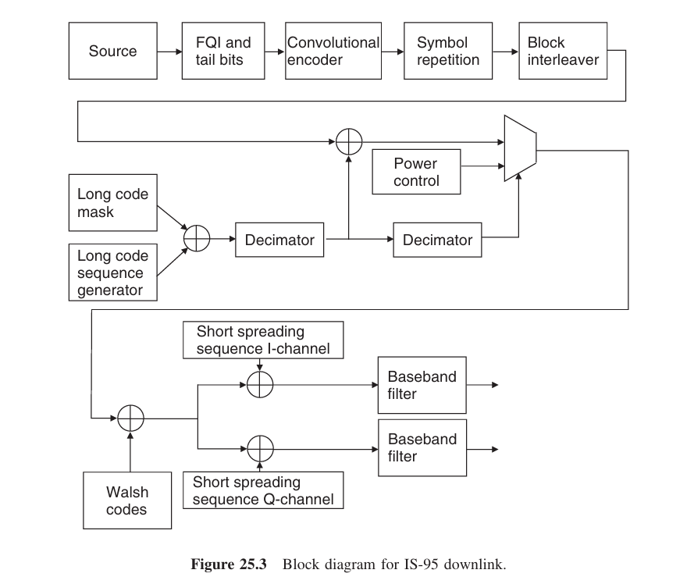

Slide 141
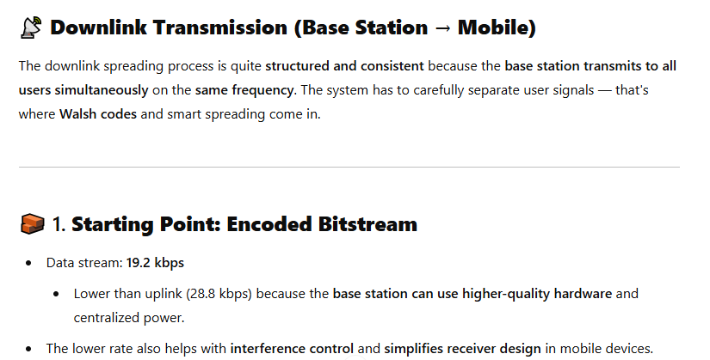

Slide 142
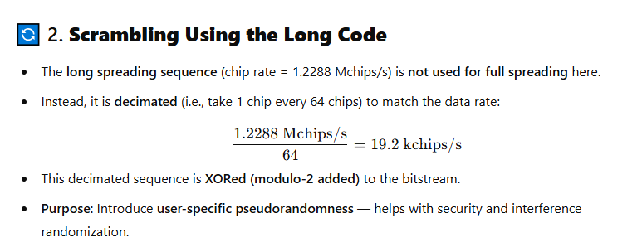

Slide 143
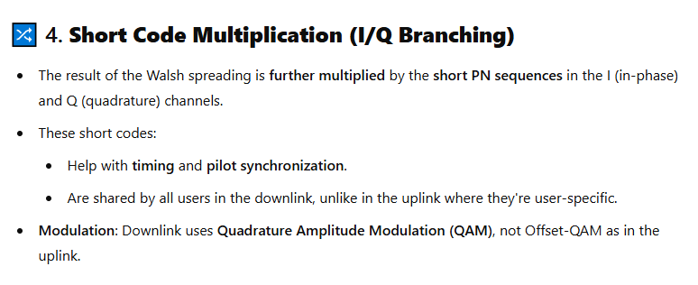

Slide 144
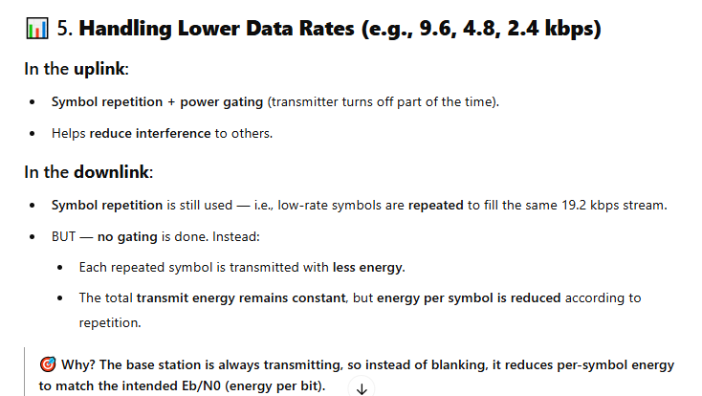

Slide 145
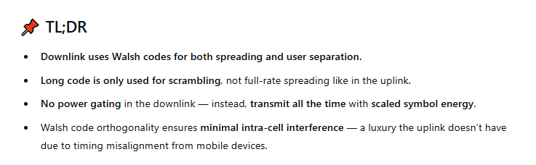

Slide 146
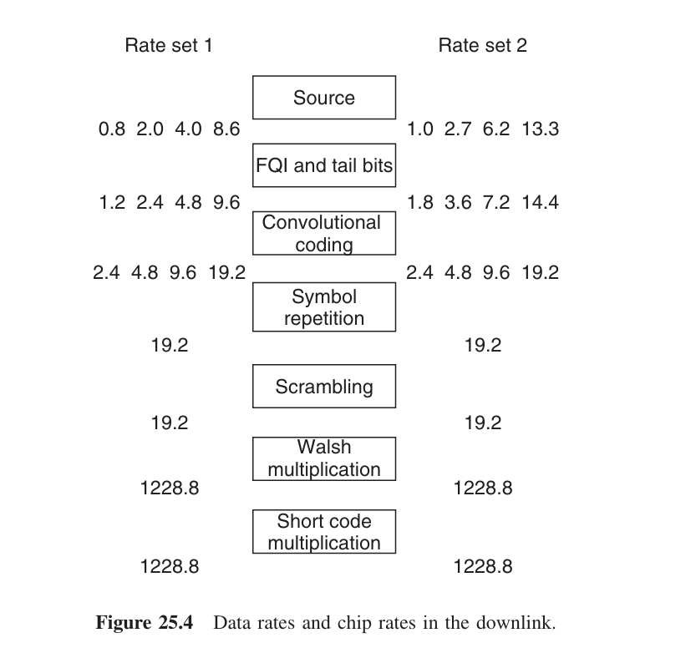

Slide 147
Uplink vs. Downlink Spreading Schemes
Asymmetry in Cellular Systems
Downlink Characteristics:
Synchronous Transmission: Signals from Base Station (BS) to Mobile Stations (MS) transmitted simultaneously.
Orthogonal Codes: Perfectly orthogonal Walsh codes can be used for spreading.
Separation Capability: Signals can be perfectly separated at the receiver due to uniform attenuation and distortion.
Spreading Factor: 64 users, with a maximum coded source data rate of 19.2 kbit/s.
Short Spreading Sequences: Used to distinguish between different BSs.

Slide 148
Uplink Characteristics
Asynchronous Reception: Signals from different users arrive at different times, making Walsh codes unsuitable for user separation.
High Cross-Correlation: Walsh codes have high cross-correlation with arbitrary time shifts, complicating separation.
Channelization via PN-Sequences: Low cross-correlation for arbitrary time shifts allows effective user separation.
Walsh Codes in Modulation: Used to represent 6 bits with a 64-chip symbol, providing redundancy and error correction.

Slide 149
6. HANDOVER

Slide 150
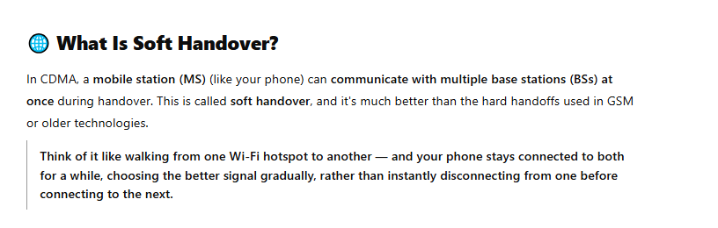

Slide 151
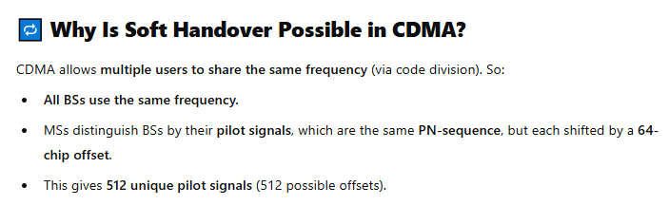

Slide 152
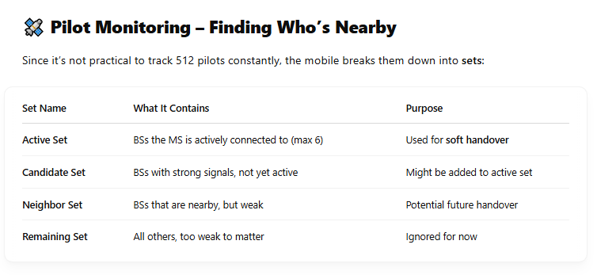

Slide 153
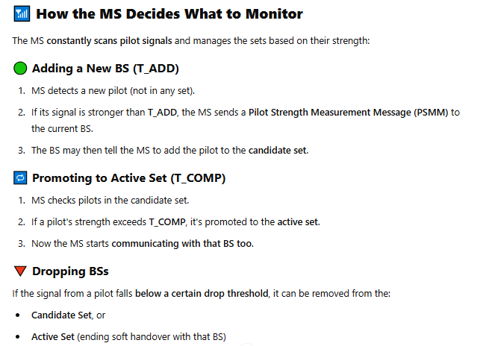

Slide 154
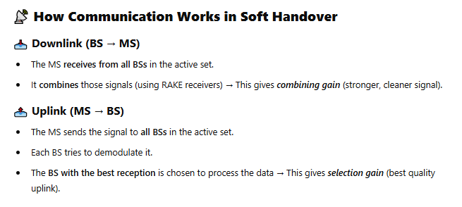

Slide 155
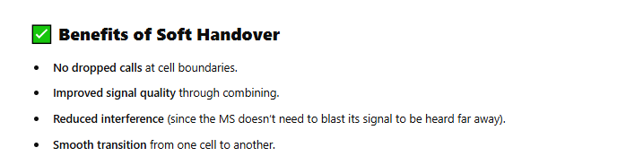

Slide 156
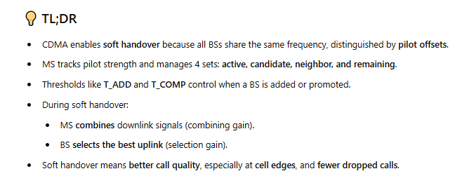

Slide 157
Soft Handover Enhances performance for Mobile Stations (MSs), especially at cell edges.
Pilot Signal Mechanism
Pilot Signals: Each Base Station (BS) transmits the same PN-sequence with a 64-chip offset.
Total Pilots: Up to 512 possible pilot signals observed by MS.
Pilot Sets Classification
Active Set:
Contains pilots available to the MS (up to 6).
Candidate Set:
Strong enough to be demodulated but not in the active set.
Neighbor Set:
Nearby BSs with insufficient strength to enter the candidate set.
Regularly updated list sent by the BS.

Slide 158
Monitoring and Assignment
Thresholds:
T_ADD: Threshold for adding a new pilot to the candidate set.
T_COMP: Threshold for moving a pilot to the active set.
Pilot Strength Measurement:
MS sends a Pilot Strength Measurement Message (PSMM) if a pilot exceeds T_ADD.
BS can direct the MS to add pilots.
Communication During Soft Handover
Downlink: MS combines signals from multiple BSs, providing combining gain.
Uplink: BSs in the active set select the one with the best signal quality for demodulation, providing selection gain.

